Slide 1

INX Future INC Employee

Slide 2
Case Statement
INX Future Inc, (referred to as INX ), is one of the leading data analytics and automation solutions providers with over 15 years of global business presence. INX is consistently rated as top 20 best employers past 5 years. INX human resource policies are considered employee friendly and widely perceived as best practices in the industry.
In recent years, employee performance indexes are not healthy and this is becoming a growing concern among the top management. There have been increased escalations in service delivery and client satisfaction levels came down by 8 percentage points.
CEO, Mr.Brain, knows the issues but is concerned to take any actions in penalizing non-performing employees as this would affect the employee morale of all the employees in general and may further reduce the performance. Also, the market perception best employer thereby attracts the best talents to join the company.
Mr.Brain decided to initiate a data science project, which analyses the current employee data and finds the core underlying causes of these performance issues. Mr.Brain, being a data scientist himself, expects the findings of this project will help him to take the right course of action. He also expects clear indicators of non-performing employees, so that any penalization of the non-performing employee, if required, may not significantly affect other employee's morals.

Slide 3
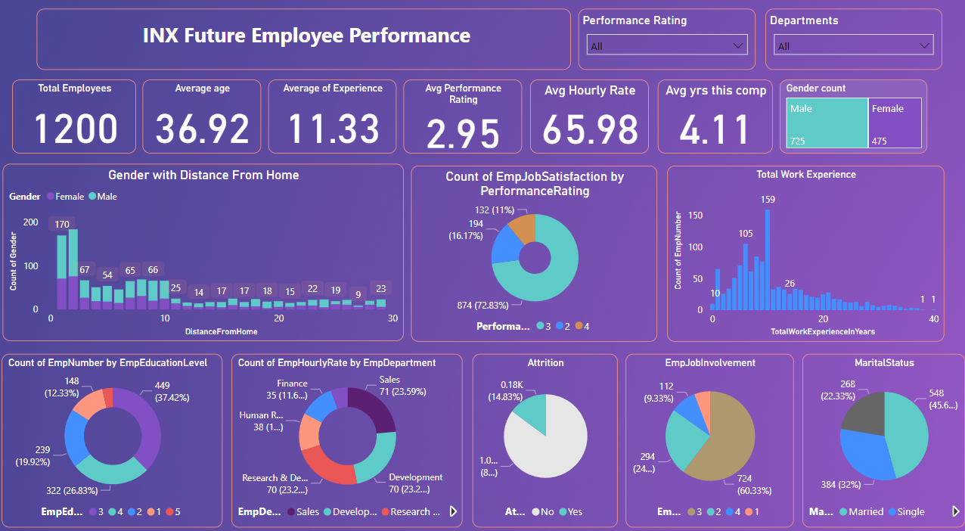

Slide 4
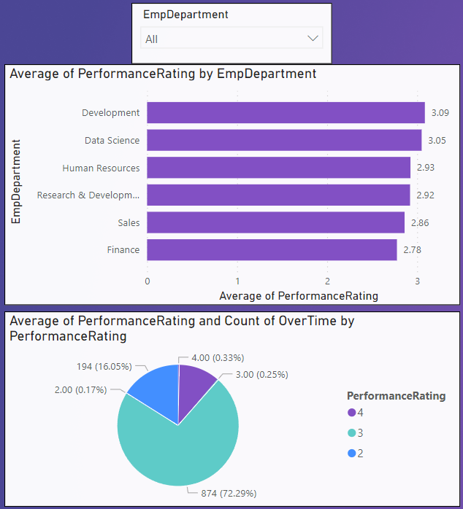
Data Analysis
There are 1200 Employee’s in the company, with 6 departments, with a diverse range of job roles totaling 19 across all departments
The development department has the highest average performance which is 3.9 compared to other departments and,
The finance department has the lowest performance at 2.78
The performance rating is described as
1 ‘Low’
2 ‘Good’
3 ‘Excellent’
4 ‘Outstanding’

Slide 5
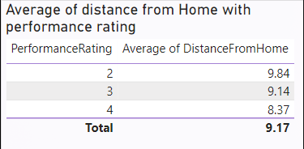
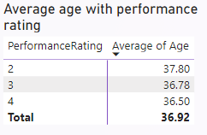
• Employees who are at more distance from home have low performance ratings which state that maybe employees are irregular or less dedicated to their work performance
• Employees of high age have low performance ratings which states that maybe employees in higher management are not working in good substance

Slide 6
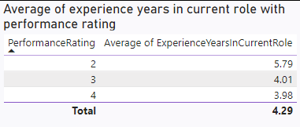
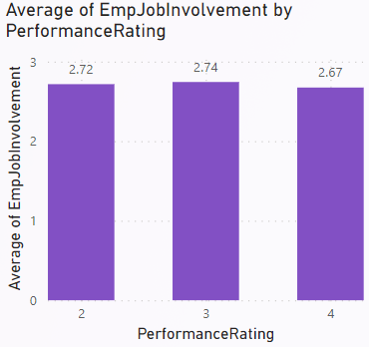
• Employees who are less experienced in their current role have performance ratings that mean employees working in their current roles do not have the required skills as they are low performer
﻿Employees at 3 (2.74) had the highest Average of Job Involvement followed by 2 at 2.72 2.60% higher than 4, which had the lowest Average of Emp Job Involvement at 2.67.﻿

Slide 7
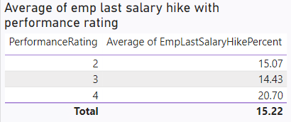
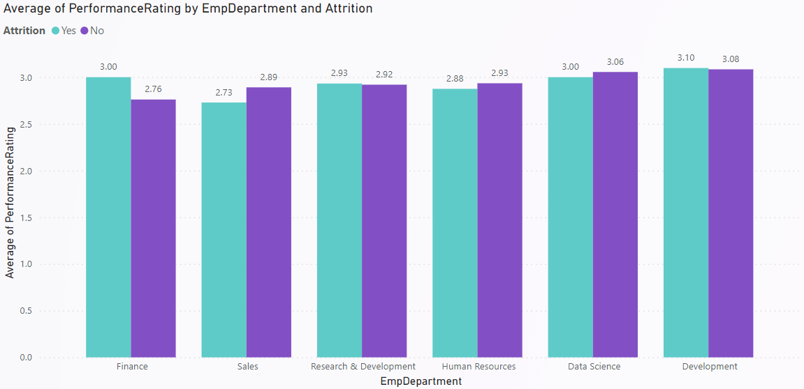
Employees who are having less salary hike also have low performance ratings, this is also impactful for an employee who is not giving his best
The Employee Department Development in Attrition Yes made up 0.2% of the Average Performance Rating.﻿﻿ ﻿﻿ ﻿
﻿The Employee Department of Finance, in attrition Yes was 0.24 higher than No in Performance Rating.﻿﻿ ﻿﻿

Slide 8
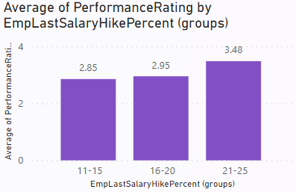
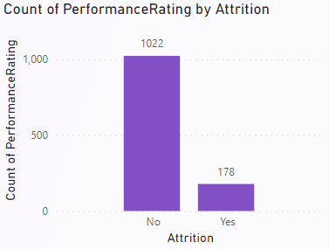
Employees hike rate percentage rate at﻿﻿ ﻿﻿21-25 had the highest Average performance rating at 3.48, followed by 16-20 at 2.95 and 11-15 at 2.85.﻿﻿ ﻿﻿ ﻿﻿11-15 had a 2.85
Out of the 1200 employees, 178 of them going to leave INX Future Inc. data analytics company (indicating a 15% attrition rate

Slide 9
Conclusion:
Salary hike percentage rates influence performance ratings, as employees with lower salary hikes tend to have lower performance ratings. This emphasizes the importance of fair and competitive compensation in motivating and retaining high-performing employees.
Attrition rates in the development and finance departments further highlight potential concerns. The analysis indicates that attrition in the finance department correlates with lower performance ratings, suggesting a need for attention and intervention in this area.
Job involvement also plays a role, with employees at level 3 exhibiting the highest average job involvement, indicating a positive correlation between engagement and performance.
Distance from home, age, and experience in current roles are impacting performance ratings, Employees dwelling far from the workplace, older individuals and those with less experience in their current roles make performance low, This impacts potential challenges to management and skill development in the workplace
Additionally, employees in the 18-24 age group have the highest average performance rating, reinforcing the importance of understanding and catering to the needs of different age demographics in the workforce.

Slide 10
Thank you
Vinod Kumar

